Slide 1

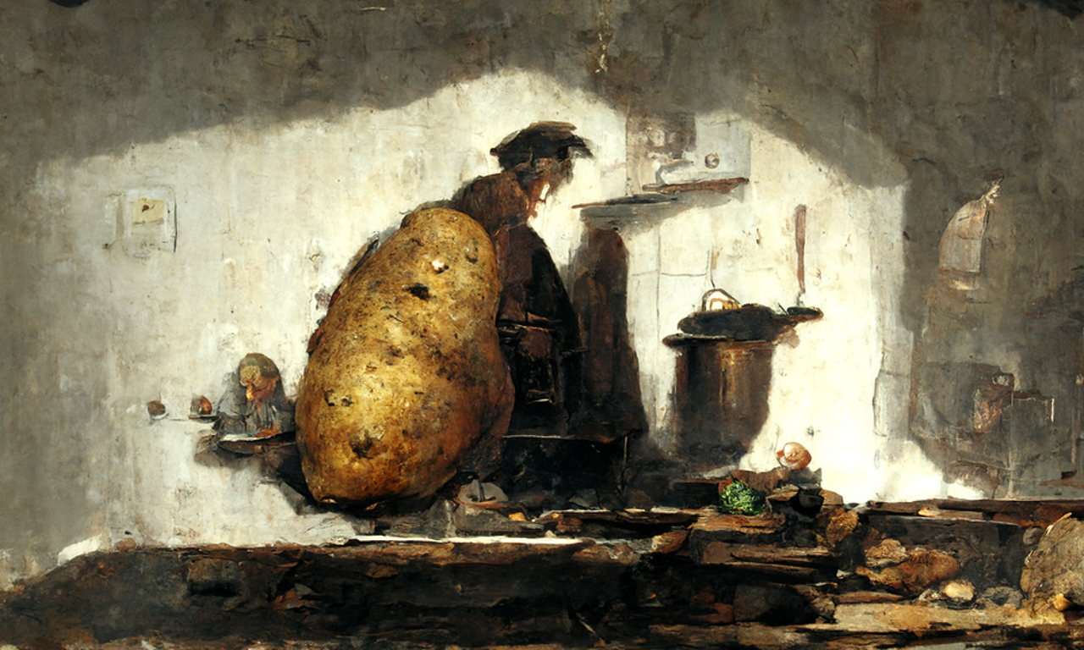
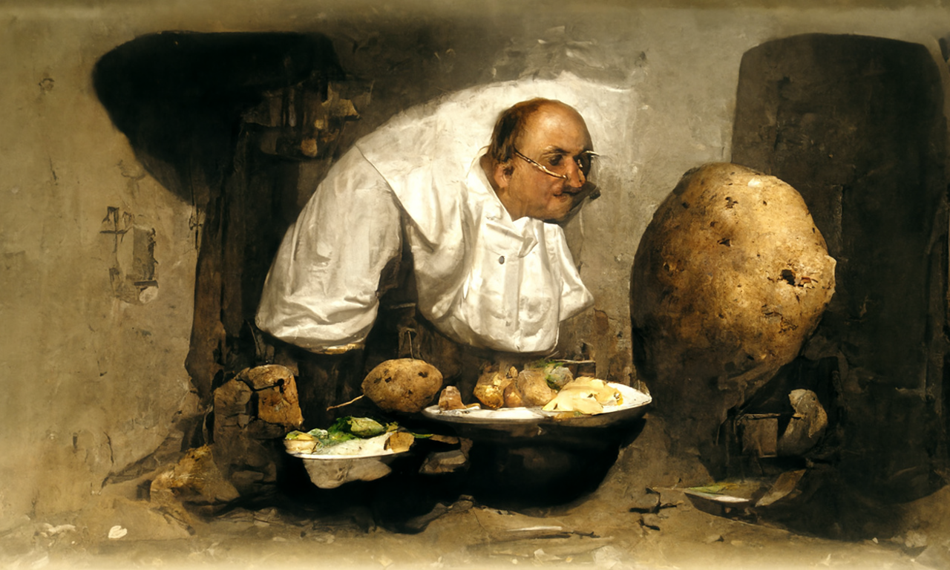
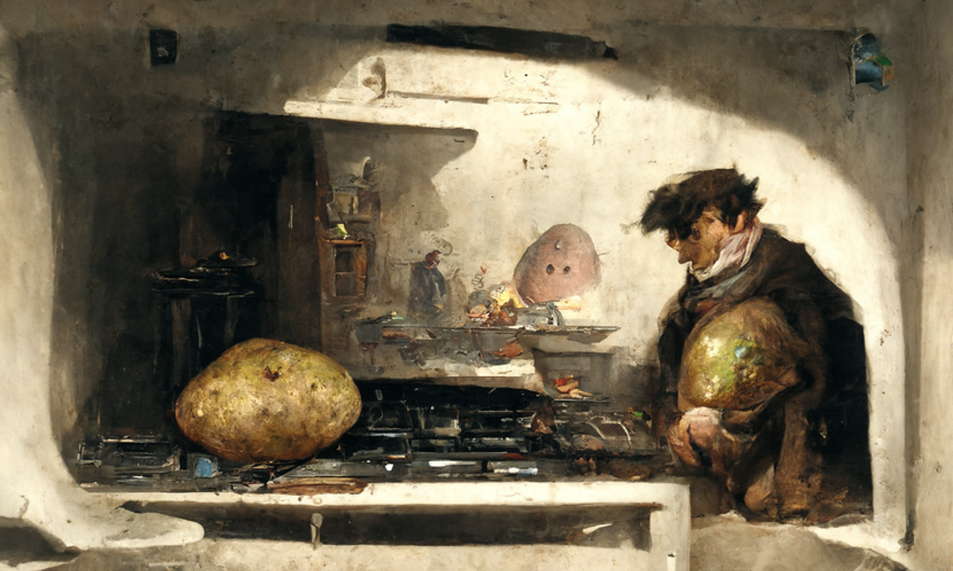
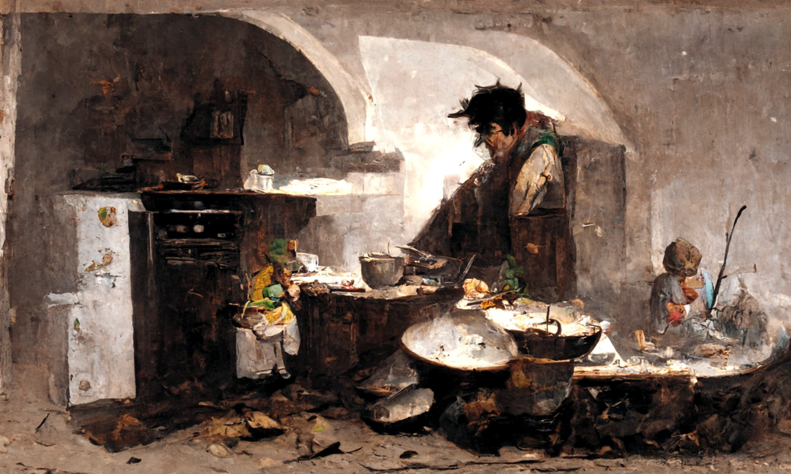
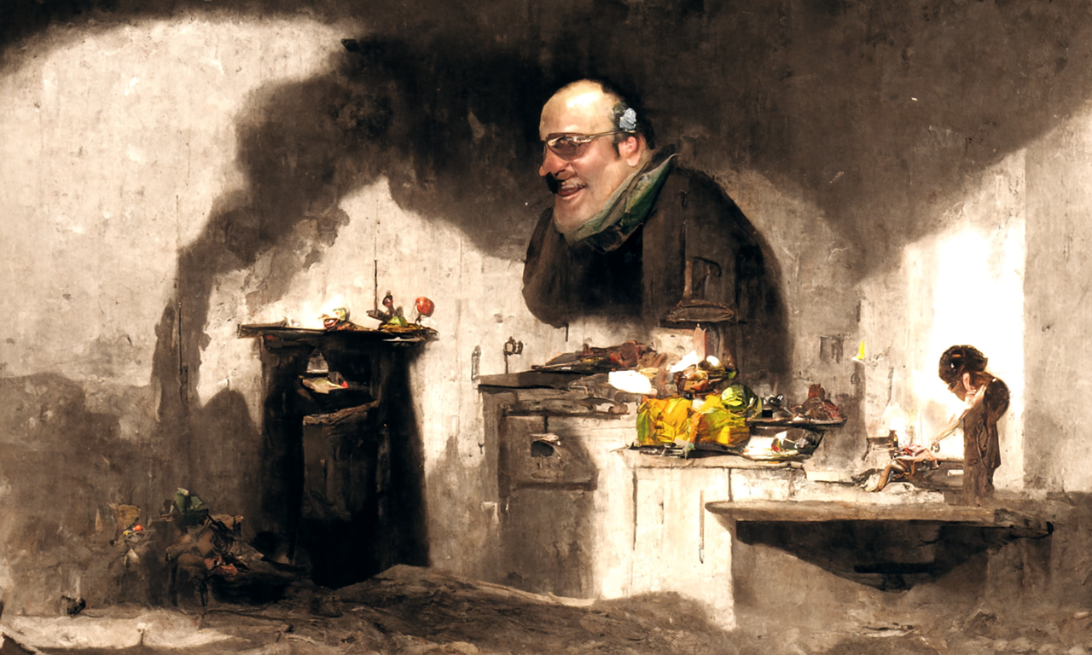
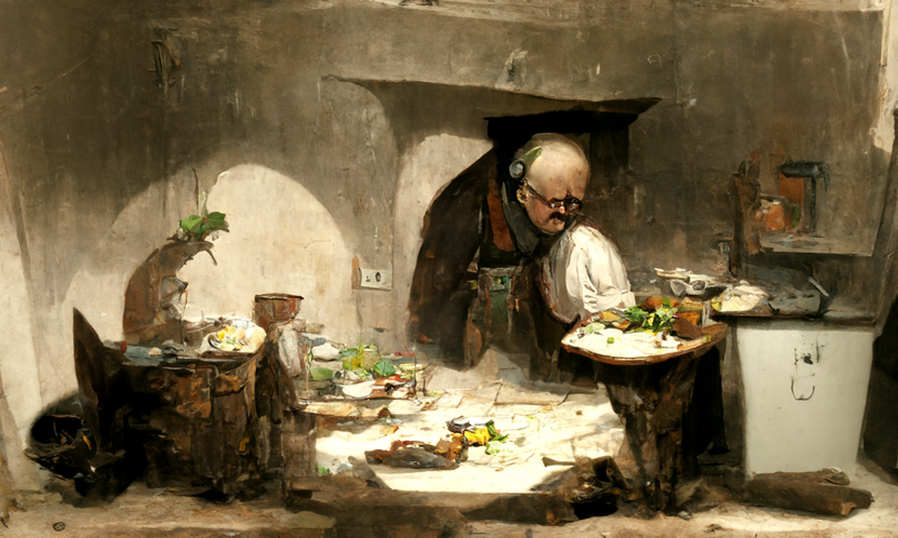
joy
trust
joy
trust
anticipation
anticipation
[...]
[...]
anger
fear
anger
fear
Background
disgust
surprise
disgust
surprise
sadness
sadness
Leveraging Large Language Models for Creative Story Generation
Ethan turned the oven on.
joy
trust
joy
trust
anticipation
anticipation
[...]
[...]
He pulled it out.
He ate it for dinner.
anger
fear
anger
fear
disgust
surprise
disgust
surprise
sadness
sadness
joy
trust
joy
trust
He put a potato in the oven.
It cooked for an
hour.
anticipation
anticipation
[...]
anger
[...]
fear
anger
fear
disgust
surprise
disgust
surprise
sadness
sadness
Yuetian Chen & Brendan Capuzzo
User-involved creation
CSCI 4968-01
Machine Learning and Optimization, Spring 2023
Suddenly, he smelled it burning.
Afterwards, he ruined dinner.

Slide 2
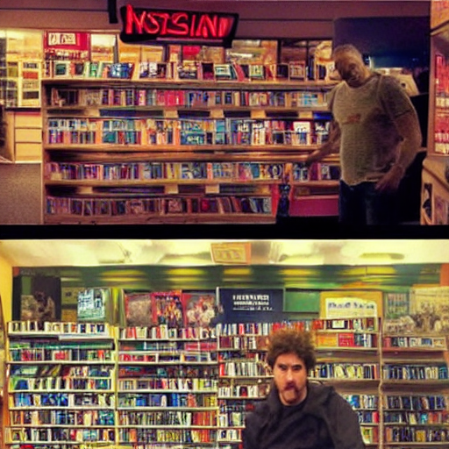
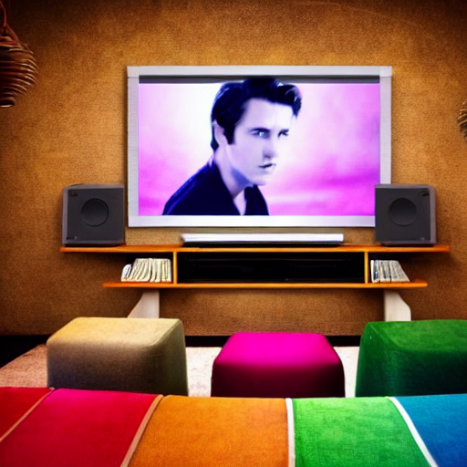
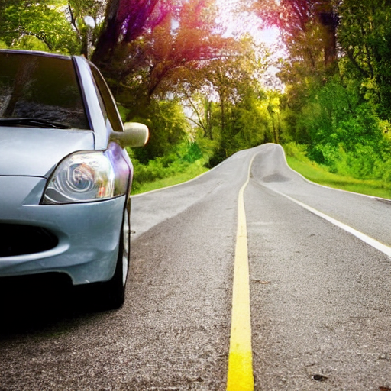
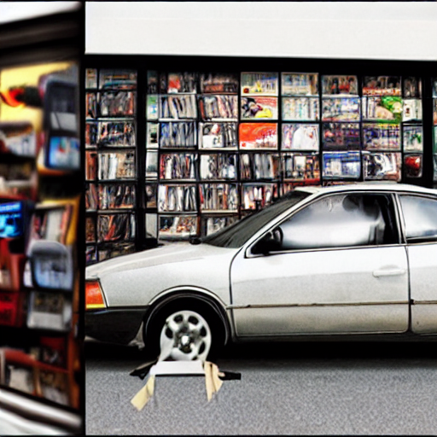


Leveraging Large Language Models for Creative Story Generation
I,
my car,
the road
joy
trust
joy
trust
anticipation
anticipation
[...]
[...]
anger
fear
anger
fear
Background
disgust
sadness
surprise
disgust
sadness
surprise
I wanted to do a different thing than the usual.
joy
trust
joy
trust
anticipation
anticipation
[...]
[...]
anger
fear
anger
fear
I went inside and rented a movie.
I brought the movie home and watched the whole thing.
disgust
sadness
surprise
disgust
sadness
surprise
joy
trust
joy
trust
anticipation
anticipation
I got into my car and went on the road.
[...]
anger
[...]
I stopped at a blockbuster video store
fear
anger
fear
disgust
sadness
surprise
disgust
sadness
surprise
Yuetian Chen & Brendan Capuzzo
User-involved creation
CSCI 4968-01
Machine Learning and Optimization, Spring 2023
I was forced to watch a movie
Thankfully I got home safely.
Notes:
Hi everyone. This is Yuetian.(And I am Bowen) Today we’d like to share with you some ideas presented in our work: “Visual Story Generation Based on Emotional and Keyword Scheme”. This project is also conducted by Ruohua, Peiru who are not with us today. And is also under the guidance of Prof. Si and affiliated with Rensselaer Polytechnic Institute.
In this work, we designed an end-to-end framework that encourage interactive narrative experience based on keyword control and it also comes with automatically generated images for every stage of stories to help users to have a better understanding of story progress. As you can see from the example presented on our right, we used an example from ROCStories dataset, which we will describe in detail later. We can see that the whole story is about Ethan making potatoes. By adjusting the sentiment, our framework enables real-time
plot tree expansion and effectively changes the story direction.
, [work through the picture...]
This is also part of the keywords we offer for modification.

Slide 3
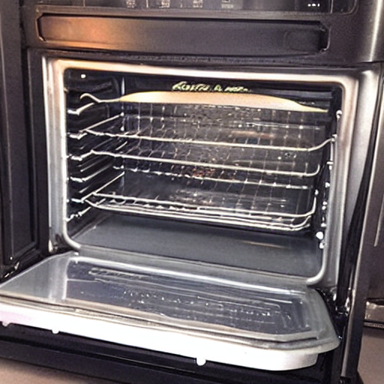
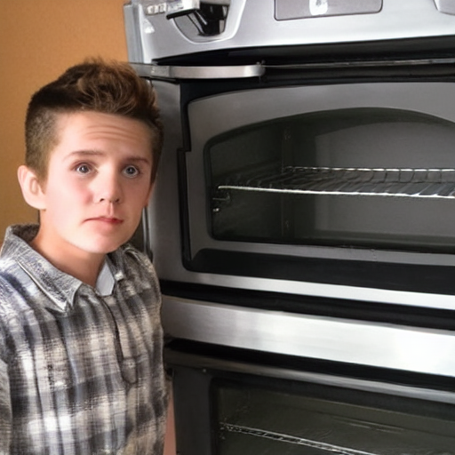
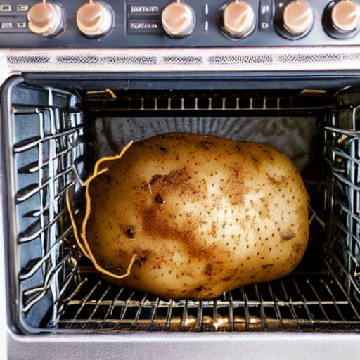
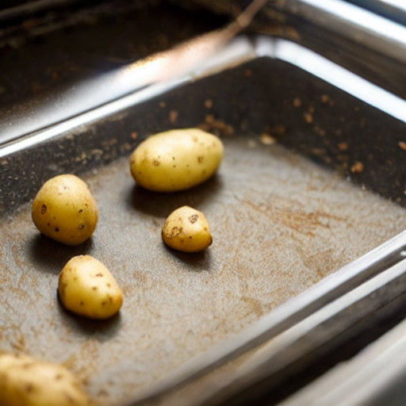
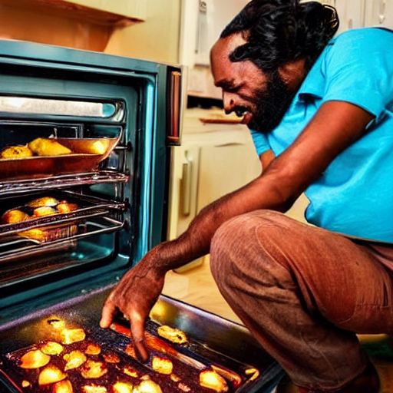
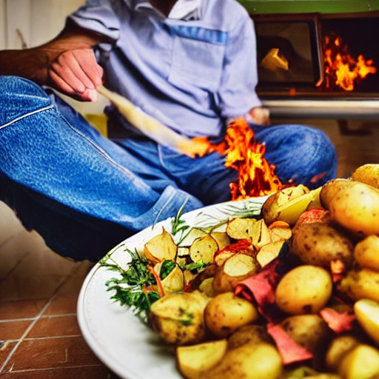
Visual Story Generation Based on Emotional and Keyword Scheme
Ethan turned the oven on.
He put a potato in the oven.
Suddenly, he smelled the potato is burning
Yuetian Chen, Ruohua Li, Bowen Shi, Peiru Liu, & Mei Si
Rensselaer Polytechnic Institute
…
…

Slide 4
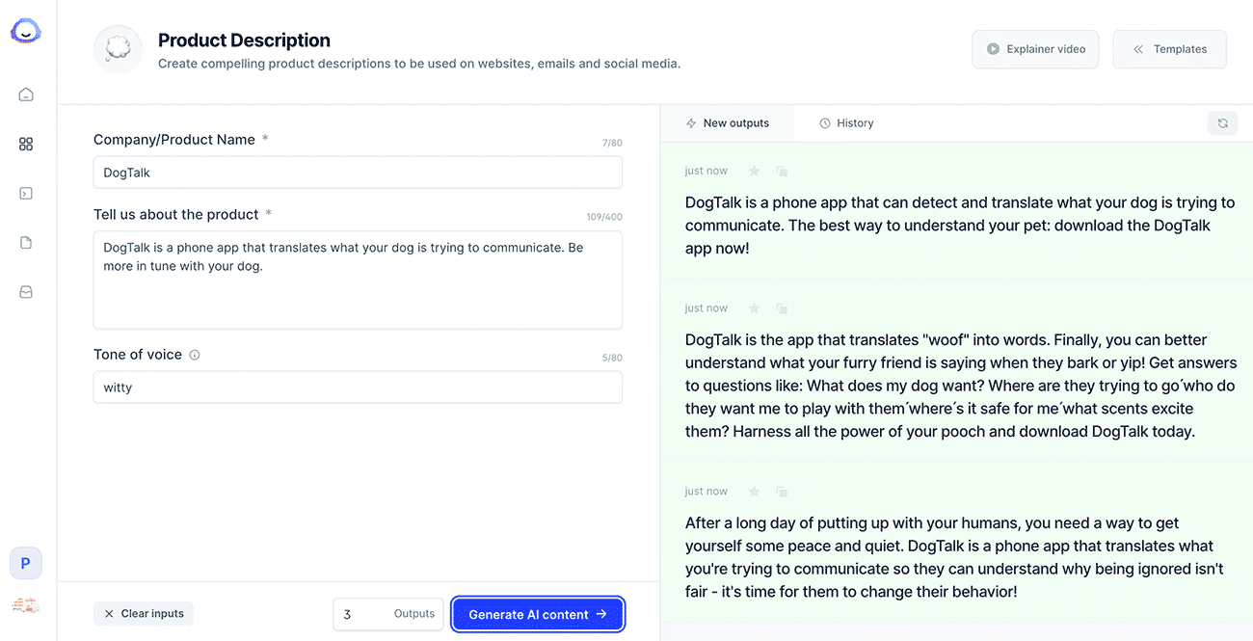
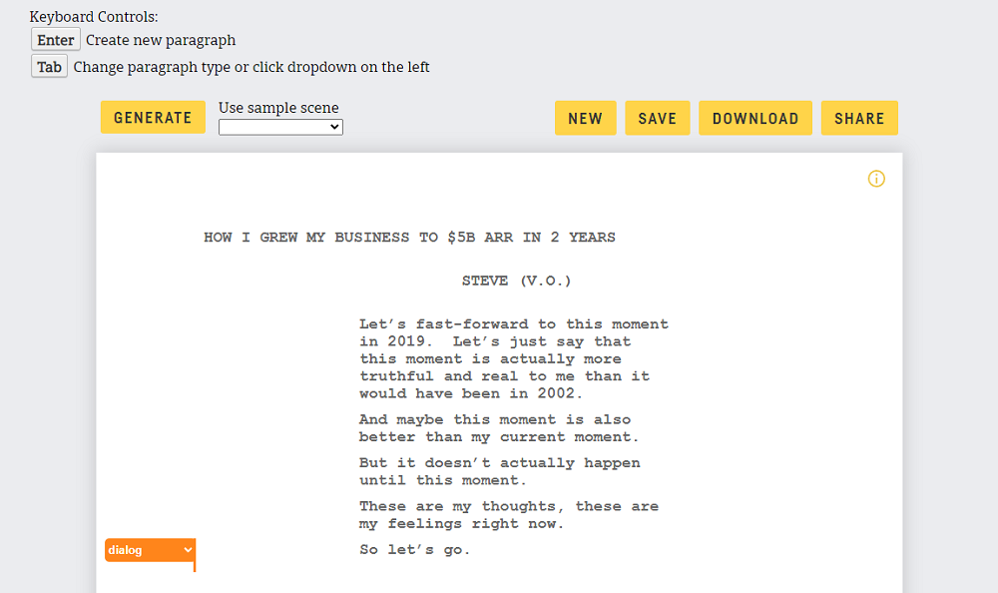
Motivation
Interactive authoring system for story generation
Commercial AI text generators
→ Jasper: https://www.jasper.ai/
→ Rytr: https://rytr.me/
…
No direct control over the generated content
No image generation
→ Even if invoking a separate image generation process
→ Can’t incorporate content from the generated images into future storytelling
Interactive authoring system
→ Control story with keywords and emotions
→ Image generation
→ Efficient knowledge distillation
Notes:
Presenter:
Brendan
I will now talk about the motivation for choosing this project. Interactive narrative generation has attracted significant attention from entrepreneurs, as it allows for the creation of stories with high coherence and consistency. In the realm of commercial AI text generators, Jasper and Rytr are notable examples. However, these platforms have limitations. One, they do not provide direct control over the generated content. Additionally, they lack image generation capabilities, even if a separate image generation process is invoked. Also, content from the generated images cannot be incorporated into future storytelling, limiting their potential for multimedia storytelling applications.
Our project explores controlling story development using user-specified keywords and emotions. We propose an interactive visual story generation pipeline with image generation and object detection. The generated keywords act as suggestions for users. Our flexibility with story generation allows users to combine image and narrative generation in harmony. The image generation and detection portion are fueled by a Stable Diffusion method for image generation, but this is not the focus of our project.
In this project specifically, we take inspiration from knowledge distillation techniques and apply them to our interactive visual story generation pipeline. By incorporating a distilled language model into our system, we aim to maintain the powerful text generation capabilities of the large language model while ensuring a more efficient and computationally feasible solution for real-time user interaction.

Slide 5
Related Work
Interactive authoring system for story generation
Neural-based story generation
→ Tambwekar, P.; et al. 2019. Controllable Neural Story Plot Generation via Reward Shaping.
Lili Yao; et al. 2019. Plan-and-Write: Towards Better Automatic Storytelling.
Knowledge Distillation
→ Zhen Huang; et al. 2021. Revisiting knowledge distillation: An inheritance and exploration framework
→ Yoon Kim; et al. 2016. Sequence-level knowledge distillation
→ Victor Sanh; et al. 2020. Distilbert, a distilled version of bert: smaller, faster, cheaper and lighter
Notes:
Presenter:
Brendan
Over the past several years, there has been an influx in research work on AI-based story generation. Most recently, model-based generation has attracted a lot of attention. Much of the work since 2019 in this field has revolved around fine-tuning large language models for text generation. I’m going to briefly go through some of these research papers that relate to our project and have provided inspiration for our work.
In "Controllable Neural Story Plot Generation via Reward Shaping", authors propose a reward-shaping technique that uses reinforcement learning to improve story generation by considering factors like grammar, coherence, and enjoyment. In "Plan-And-Write: Towards Better Automatic Storytelling", authors introduce a "Plan-and-Write" structure for large language models, using user-generated prompts and storylines to guide story generation with dynamic or static plots.
Fine-tuning is another technique used in story generation with large language models to refine the model's performance by adapting it to specific story prompts or user-generated inputs, enabling more tailored and controlled story generation.
The paper "Revisiting knowledge distillation: An inheritance and exploration framework" introduces a new framework for knowledge distillation, incorporating inheritance and exploration components to prevent the student model from learning incorrect information. "Sequence-level knowledge distillation" proposes a sequence-level approach with teacher forcing and soft targets for effective knowledge transfer. "DistilBERT, a distilled version of BERT: smaller, faster, cheaper and lighter" presents a more efficient version of BERT achieved through distillation, retaining most capabilities with reduced size and faster inference time.

Slide 6

Statement of the work
Interactive authoring system for story generation
Automated Suggester
User Suggestion
Separate authoring need from story composition
→ User-controlled story generation with:
User’s intention on key information
Priori knowledge of language models
Knowledge distillation in finetuning procedure
→ Transfer knowledge to a smaller student model
→ Resulting model is more efficient with reduced computational resources
Image generation prompted by text content
→ Enhance the flexibility in generation
→ Create immersion for design process
→ Provide potential creation suggestions based on image content
Prompt + Teacher LM
Prompt + Student LM
…
…
…
…
Generated Stories
Notes:
Presenter:
Yuetian
And for our framework. The first thing that needs to be made clear is that unlike previous approaches like Rytr or Jasper, that to implement an interactive story generation by modifying the storyline itself, we intend to introduce more control to this process that we can make use of both priori knowledge of language models and user’s creativity that brings immersion and manual control to the plots. By giving the language model the prompt that includes key information, which we will discuss in detail later, in the next stage of the story. This allows the story to be logical while still accepting the evaluation from the users.
As for the controlled image generation implementation, we produced a pipeline based on prompt learning to generate images in real time based on the content provided in the above process to further enhance the flexibility of story generation as well as to further couple the text-to-image process into our framework. In the next slides, we will elaborate further on the challenging part of the implementation of these two points.

Slide 7
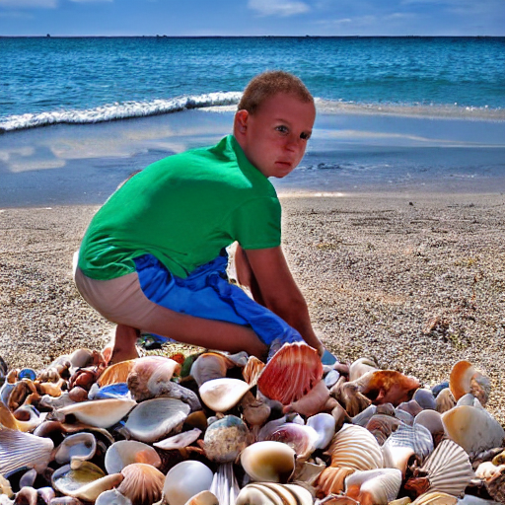
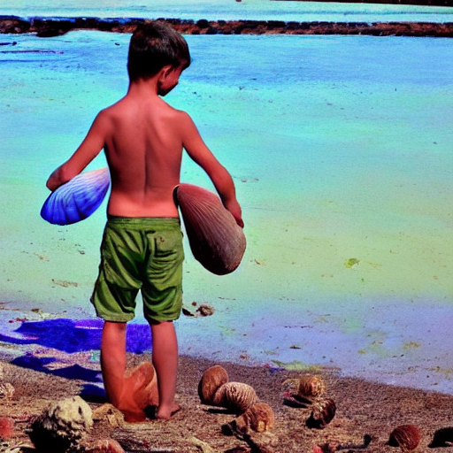


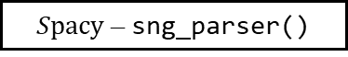



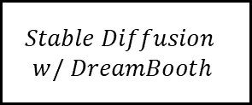
Object Detection
Bring Language Model to Story Generation
Basic Principle: Visual + Text Interactive Generation
Background
Context
Emotion Classifier
Marcus was collecting shells on the beach.
CNN
$${RoBERTa}_{NEXT EMO}$$
He picked up a large beautiful shell.
$${BERT}_{NEXT EMO}$$
Real-time
Keyword Generator
$Spacy$ – sng_parser()
Explicit Key Information
Prompt Template
Object Detection
Object Detection
Keyword
Emotion
Generate next sentence
based on following
<extra_id_0>KEYWORDS: […]
<extra_id_0>CONTEXT: […]
<extra_id_0>EMOTION: […]
Prompt learning
Next Sentence
Generation
User Involvement
Text Pipeline
Visual Pipeline
$$OPT 1.3b$$
$$Stable Diffusion$$
$$w/ DreamBooth$$
Visual & Text
$$T5_{base} Finetuned CommenGen$$
Object Detection
Notes:
But before we enter the next stage, we want to re-emphasize that we want to design a framework that invites the user to control the story generation. Therefore, the above model can only provide a suggestion based on statistically-consistent cognitive habits, and its output is fully modifiable by the user before being imported to the next step. Afterwards, this information will be entered in the appropriate place in the prompt template and carried forward to the next step. In the last step, we run the text as well as the image generation as two pipelines in parallel. The image part will be used to provide users with references and generate keyword recommendations using YOLO or FAST RCNN that can import to the prompt template just as how keyword generator did in the next iteration, while the text part will also iteratively go back to the first step and serve as the context for further content generation. For the text, in order to make the model understand the content and value that each set of information brings, I think we need to start introducing our training strategy and the dataset used.

Slide 8






Object Detection
Bring Language Model to Story Generation
Basic Principle: Visual + Text Interactive Generation
Background
Context
Emotion Classifier
Marcus was collecting shells on the beach.
CNN
$${RoBERTa}_{NEXT EMO}$$
He picked up a large beautiful shell.
$${BERT}_{NEXT EMO}$$
Real-time
Keyword Generator
$Spacy$ – sng_parser()
Explicit Key Information
Prompt Template
Object Detection
Object Detection
Keyword
Emotion
Generate next sentence
based on following
<extra_id_0>KEYWORDS: […]
<extra_id_0>CONTEXT: […]
<extra_id_0>EMOTION: […]
User Involvement
Prompt learning
Next Sentence
Generation
Text Pipeline
Visual Pipeline
Object Detection
$$OPT 1.3b$$
$$Stable Diffusion$$
$$w/ DreamBooth$$
Visual & Text
$$T5_{base} Finetuned CommenGen$$
Object Detection
Notes:
But before we enter the next stage, we want to re-emphasize that we want to design a framework that invites the user to control the story generation. Therefore, the above model can only provide a suggestion based on statistically-consistent cognitive habits, and its output is fully modifiable by the user before being imported to the next step. Afterwards, this information will be entered in the appropriate place in the prompt template and carried forward to the next step. In the last step, we run the text as well as the image generation as two pipelines in parallel. The image part will be used to provide users with references and generate keyword recommendations using YOLO or FAST RCNN that can import to the prompt template just as how keyword generator did in the next iteration, while the text part will also iteratively go back to the first step and serve as the context for further content generation. For the text, in order to make the model understand the content and value that each set of information brings, I think we need to start introducing our training strategy and the dataset used.

Slide 9

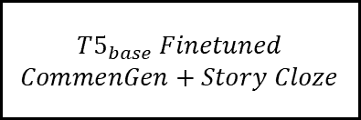


Object Detection
Bring Language Model to Story Generation
Basic Principle: Visual + Text Interactive Generation
Background
Context
Emotion Classifier
Marcus was collecting shells on the beach.
CNN
He picked up a large beautiful shell.
Real-time
Keyword Generator
Explicit Key Information
Prompt Template
Object Detection
Object Detection
Keyword
Emotion
Generate next sentence
based on following
<extra_id_0>KEYWORDS: […]
<extra_id_0>CONTEXT: […]
<extra_id_0>EMOTION: […]
User Involvement
Prompt learning
Next Sentence
Generation
Text Pipeline
Visual Pipeline
Object Detection
Visual & Text
Object Detection

Slide 10
Story Co-generation with Prompting Learning
1. Current Situation of Short Narrative Creation
Previous Work: Automatic Story Generation Task
Fundamental Challenges of Context-based Generation
2. Bring Language Model to Story Generation
Basic Principle: Visual + Text Interactive Generation
3. Implementation of an End-to-end Pipeline
Part 1 – Text pipeline
→ Named Entities + Sentiments Label + Context = Controlled story…
Part 2 – Image pipeline
→ Generated stylized illustrations using Stable Diffusion, Disco Diffusion …
4. Advantages on Narrative Co-generation
Demo
5. Future Improvement on Prompting and Framework Strcture
Continuous prompting…

Slide 11
Current Situation of Short Narrative Creation
Previous Work: Automatic Story Generation Task
Automated planning & scheduling based
→ Story generation planning based on decision theory
Tale-Spin (Meehan, 1976),
CBR-based system(Gervás, 2005),
IPOCL planner(Riedl, 2010)
Natural language model based
Plot centric story generation guided by story corpus
skip-thought vectors(Kiros, 2015)
CaTeRS (Mostafazadeh, 2016)

Slide 12
Current Situation of Short Narrative Creation
Dataset Format & Story Generation Process
Automated Suggester
User Suggestion
Prompt + Language Model
…
…
…
…
Generated Stories

Slide 13
Implementation of an End-to-end Pipeline
Dataset Format & Story Generation Process
ROCStories (Story Cloze Test)
→ A dataset evaluating narrative structure learning
98,159 stories
→ Each story has a similar structure
Short narrative with five sentences
Logic & progression between sentences
Writing Prompts
→ 303,358 pairs of writing prompts and human- written stories
→ Sourced from Reddit's r/WritingPrompts forum
→ Diverse topics, lengths, and ideas
index | Sentence
0 | Marcus was collecting shells on the beach.
1 | He picked up a large beautiful shell.
2 | He put it in his pocket to save for later.
3 | Suddenly he felt a sharp pinch.
4 | A crab was inside the shell pinching his leg.
index | Sentence
0 | Oswald decided to write a novel.
1 | He worked on his book for several months.
2 | Oswald took his book to a publisher.
3 | The publisher rejected his book almost immediately.
4 | Oswald decided to give up on writing.
Sample narratives quoted from Story Cloze
Notes:
Presenter: Brendan
To finetune this language model, we mainly used story content based on ROCStories as our dataset, where each group of stories consists of five sentences and during the crowdsourcing process, a narrative creator was asked to make sure that stories are making progress while keeping its coherence and consistency. The ROCStories dataset consists of over 98,000 stories. Specifically, some sample stories are placed on your right-hand side, where we can see the robustness and logic provided by the stories.
Marcus – Twist is in index 3 when he suddenly felt a pinch
Oswald – Twist is in index 3 when the publisher rejects the book – Mention that Yeutian will show us how to control the ending of this story in a more positive way.
Notice how these stories are not just a regurgitation of words or sentences it’s seen before. They are logical stories with conflict, resolution, and plot.
Additionally, we used another dataset, the WritingPrompt dataset, which consists of over 300,000 stories formatted in pairs of prompts and stories. These stories are sourced from the WritingPrompts Reddit forum where a diverse group of people spanning across geographical locations, ethnic backgrounds, and age groups have contributed their stories. With the story diversity, each story varies in length, style, and their unique ideas.

Slide 14
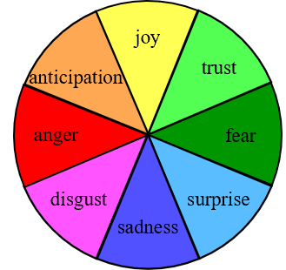
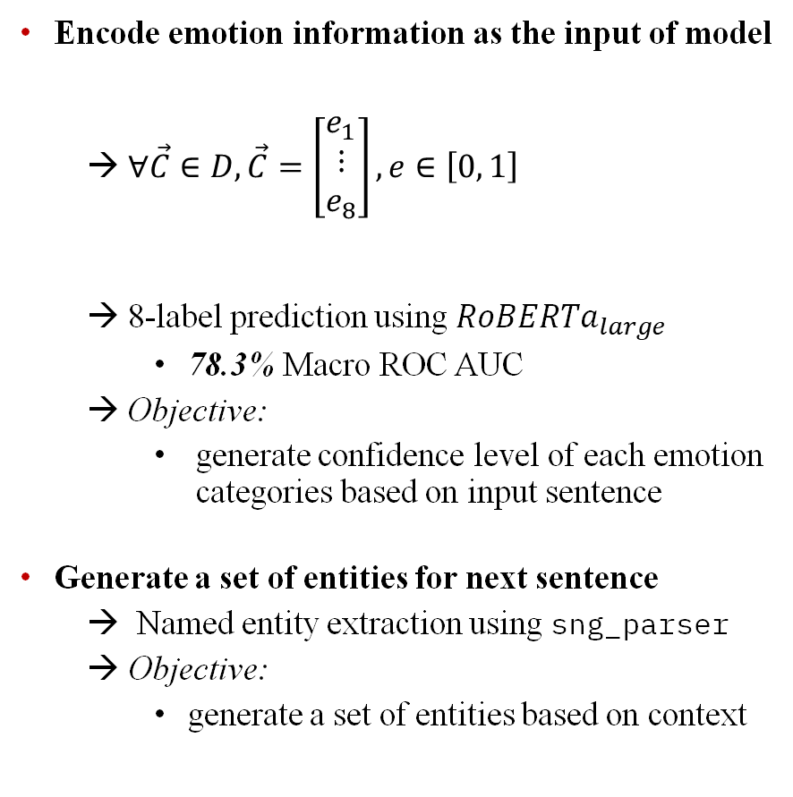


Implementation of an End-to-end Pipeline
Text pipeline
Encode emotion information as the input of model
→ $∀\vec{C}∈D, \vec{C}=\left[\begin{matrix}e_{1} \\ ⋮ \\ e_{8}\end{matrix}\right], e∈\left[0, 1\right]$
→ 8-label prediction using ${RoBERTa}_{large}$
78.3% Macro ROC AUC
→ Objective:
generate confidence level of each emotion categories based on input sentence
Generate a set of entities for next sentence
→ Named entity extraction using sng_parser
Objective:
generate a set of entities based on context
Context
Emotion
Named Entity
Kevin went to the beach with his wife one day.
They went into the water and began to swim around.
fear,
surprise,
sadness,
disgust,
anger
joy
Kevin,
foot
anticipation
trust
anger
fear
disgust
sadness
surprise
Prompt Template
$$OPT 1.3B$$
$$T5_{base} Finetuned CommenGen$$
Generated Next Sentence
Suddenly, Kevin felt a sharp pain in his foot.
Notes:
The story alone is not enough, we also need to visualize some additional information in the story, including emotions and characters serves as the keyword. So, we also used Story Commonsense as an additional dataset. The stories section is a subset of ROCStories and contains a sample of 15,000 stories, which is quite a bit less than the nearly 100,000 samples in ROCStories. but on top of it, it contains additional information for each story, including sentiment, motivation, character quest, etc. Here we use categorical sentiment annotation, which uses Plutchik’s wheel of emotion model that using the following 8 emotions for each stage of stories to express the emotions of the main character in the story, including …
As for the implementation of the suggester, on the sentiment predictor, we predicted the 8-class sentiment as a one-hot vector, with each entry representing one sentiment. That is, the goal of the model is reduced to a multi-label classification, that predicting the confidence level of each entry in an array of length 8. And at the end, we achieved 78.3% of the macro ROC-AUC in the prediction. Meaning that it can make valid sentiment predictions and provide quite reasonable suggestions.
As for named entities, we use sng_parser to generate named entities that have appeared before for users to choose from. In addition to this, we used the full ROCStories dataset and sng_parser again for the extraction of named entities for the next sentence. Finally, they were imported into the large-scale language model to encourage OPT to have a prediction of the named entity for the next sentence. and we can then obtain a recommender that provides named entities in a decent accuracy
By combining both results, this gives us the key information, but it's not enough for story generation, so let's go back to the previous page and further explain how to use this information next

Slide 15
Object Detection
Bring Language Model to Story Generation
Basic Principle: Visual + Text Interactive Generation
Background
Context
Emotion Classifier
Marcus was collecting shells on the beach.
CNN
$${RoBERTa}_{NEXT EMO}$$
He picked up a large beautiful shell.
$${BERT}_{NEXT EMO}$$
Real-time
Keyword Generator
$Spacy$ – sng_parser()
Explicit Key Information
Prompt Template
Object Detection
Object Detection
Keyword
Emotion
Generate next sentence
based on following
<extra_id_0>KEYWORDS: […]
<extra_id_0>CONTEXT: […]
<extra_id_0>EMOTION: […]
Prompt learning
Next Sentence
Generation
User Involvement
Text Pipeline
Visual Pipeline
$$OPT 1.3b$$
$$Stable Diffusion$$
$$w/ DreamBooth$$
Visual & Text
$$T5_{base} Finetuned CommenGen$$
Object Detection

Slide 16

Current Situation of Short Narrative Creation
Fundamental Challenges of Automatic Context-based Generation
Consistency
→ No internal contradiction of story elements
properties & events of word & characters
Coherence
Events should be logically explainable
Help reader build up casual representation of events
Motivation
→ Story ≠ Predicting behavior
→ Justified surprise is fine
→ Author provides action & make actions
reasonable to reader
Ray couldn't get an irritating tune out of his head.
Next Sentence Prediction
He fell in love with the tune
Her psychiatrist diagnosed her with depression after seeing her.
Next Sentence Prediction
She was very happy.
I went to the harbor yesterday
Next Sentence Prediction
I was eating a lot of fish.
Sample provided by Zero-shot $T5_{base}$

Slide 17
Current Situation of Short Narrative Creation
Dataset Format & Story Generation Process
Story Cloze Test
→ A dataset evaluating narrative structure learning
→ Each story has a similar structure
Consists of five sentences
Contain twists of events in the middle stages
Story Commonsense
→ Use subset of Story Cloze as the basis
15,000 stories
→ Provide Plutchik’s annotation for each plot
joy, trust, fear, surprise, sadness, anticipation, anger, & disgust
index | Sentence
0 | Marcus was collecting shells on the beach.
1 | He picked up a large beautiful shell.
2 | He put it in his pocket to save for later.
3 | Suddenly he felt a sharp pinch.
4 | A crab was inside the shell pinching his leg.
A sample narrative quoted from Story Cloze

Slide 18



Bring Language Model to Story Generation
Basic Principle: Visual + Text Interactive Generation
Background
Context
Emotion Classifier
Marcus was collecting shells on the beach.
CNN
$${RoBERTa}_{NEXT EMO}$$
He picked up a large beautiful shell.
$${BERT}_{NEXT EMO}$$
Real-time
Keyword Generator
$$OPT_{1.5B}$$
Explicit Key Information
Prompt Template
Keyword
Emotion
Generate next sentence
based on following
<extra_id_0>KEYWORDS: […]
<extra_id_0>CONTEXT: […]
<extra_id_0>EMOTION: […]
User Involvement
Prompt learning
Next Sentence
Generation
Text Pipeline
Visual Pipeline
$$T5_{base} Finetuned$$
$CommenGen+Story Cloze$
$$Disco Diffusion$$
Visual & Text
$$Stable Diffusion$$

Slide 19
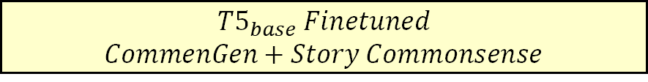
Implementation of an End-to-end Pipeline
Text pipeline
Multi-task training on multiple datasets
→ CommenGen
Constrained text generation task
Objective: Vocabulary-based sentence construction
→ Story Commonsense
Bring keywords and prompt template to task
Objective: Generate next sentence based on input
Interactive short narrative generation
Based on user-provided story background
Generate next sentence based on a triad of data
Context
Named entity
Plutchik's wheel of emotions label
Context
Emotion
Named Entity
Kevin went to the beach with his wife one day.
They went into the water and began to swim around.
fear,
surprise,
sadness,
disgust,
anger
joy
Kevin,
foot
anticipation
trust
anger
fear
disgust
sadness
surprise
Prompt Template
$$T5_{base} Finetuned$$
$CommenGen+Story Commonsense$
Generated Next Sentence
Suddenly, Kevin felt a sharp pain in his foot.

Slide 20


Implementation of an End-to-end Pipeline
Text pipeline – Teacher Model
Teacher network: OPT 1.3B
→ Source of knowledge for the student model
→ Large, pre-trained language model
→ Trained on massive datasets; capture intricate patterns and relationships
Architectural enhancements
→ Different positional encoding for processing large inputs
→ Contributes to coherent, contextually appropriate text generation
Context
Emotion
Named Entity
Kevin went to the beach with his wife one day.
They went into the water and began to swim around.
fear,
surprise,
sadness,
disgust,
anger
joy
Kevin,
foot
anticipation
trust
anger
fear
disgust
sadness
surprise
Model | # Parameters | Comparison
OPT 1.3B | 1,300,000,000 (1.3b) | OPT is 5.9x more than T5
T5-Base | 220,000,000 (220m)
Prompt Template
$$OPT 1.3B$$
$$T5_{base} Finetuned CommenGen$$
Generated Next Sentence
Suddenly, Kevin felt a sharp pain in his foot.
Notes:
In the Text pipeline, the language model we used is a T5 with finetuned CommenGen published by Manu Romero in huggingface community. By finetuning this dataset, we can gain sentences based on keyword entered. Specifically, when the input value is
The reason of selection of this model is that we want the model to be able to use the experience gained in this part of the task when performing controlled prediction tasks, that we discussed in following, so that the named entities in left-side can be effectively inserted into the next sentence generated on the right
And for our formal task that brings keywords and prompt template to task, we are now able to set context, named entity and sentiment into the template and serves as the input to get the sentence we want

Slide 21
Implementation of an End-to-end Pipeline
Text pipeline – Student Model
Multi-task pre-training on multiple datasets
→ CommenGen
mrm8488/t5-base-finetuned-common_gen
Constrained text generation task
Objective:
Vocabulary-based sentence construction
→ Story Commonsense
Bring keywords and prompt template to task
Objective:
Generate next sentence based on input
Context
Emotion
Named Entity
Kevin went to the beach with his wife one day.
They went into the water and began to swim around.
fear,
surprise,
sadness,
disgust,
anger
joy
Kevin,
foot
anticipation
trust
anger
fear
disgust
sadness
surprise
man
Prompt Template
hole
LM
A man is digging a hole near a tree
tree
$$OPT 1.3B$$
$$T5_{base} Finetuned CommenGen$$
Generated Next Sentence
Context
LM
Next plot
Suddenly, Kevin felt a sharp pain in his foot.
Keyword
Sentiment
Notes:
In the Text pipeline, the language model we used is a T5 with finetuned CommenGen published by Manu Romero in huggingface community. By finetuning this dataset, we can gain sentences based on keyword entered. Specifically, when the input value is
The reason of selection of this model is that we want the model to be able to use the experience gained in this part of the task when performing controlled prediction tasks, that we discussed in following, so that the named entities in left-side can be effectively inserted into the next sentence generated on the right
And for our formal task that brings keywords and prompt template to task, we are now able to set context, named entity and sentiment into the template and serves as the input to get the sentence we want

Slide 22
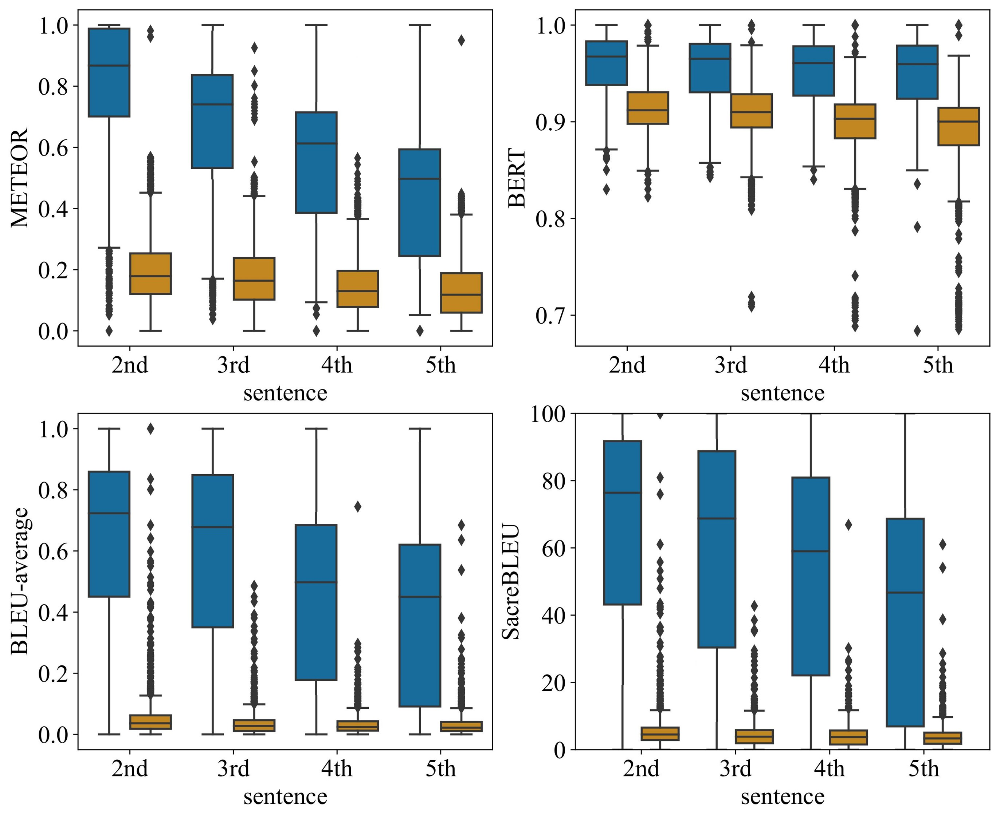
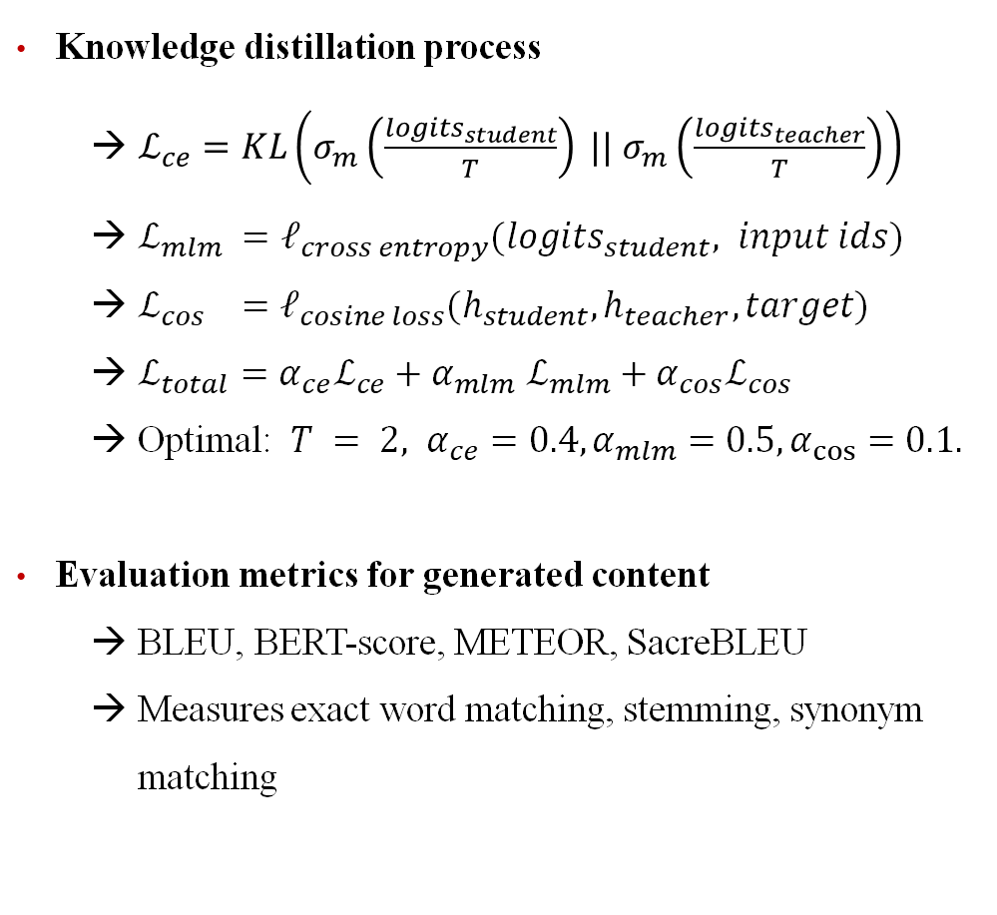
Implementation of an End-to-end Pipeline
Text pipeline – Implementation & Evaluation
Knowledge distillation process
→ $ℒ_{ce}=KL\left(σ_{m}\left(\frac{logits_{student}}{T}\right) || σ_{m}\left(\frac{logits_{teacher}}{T}\right)\right)$
→ $ℒ_{mlm} =ℓ_{cross entropy}(logits_{student}, input ids)$
→ $ℒ_{cos} =ℓ_{cosine loss}(h_{student}, h_{teacher}, target)$
→ $ℒ_{total}=α_{ce}ℒ_{ce}+α_{mlm}$ $ℒ_{mlm}+α_{cos}ℒ_{cos}$
→ Optimal: $T = 2, α_{ce}=0.4, α_{mlm}=0.5, α_{cos}=0.1.$
Evaluation metrics for generated content
→ BLEU, BERT-score, METEOR, SacreBLEU
→ Measures exact word matching, stemming, synonym matching
Experimental results
→ Improvements in evaluation metrics compared to baseline model
→ Emotions, keywords, and knowledge distillation enhance story generation quality
Notes:
In the Text pipeline, the language model we used is a T5 with finetuned CommenGen published by Manu Romero in huggingface community. By finetuning this dataset, we can gain sentences based on keyword entered. Specifically, when the input value is
The reason of selection of this model is that we want the model to be able to use the experience gained in this part of the task when performing controlled prediction tasks, that we discussed in following, so that the named entities in left-side can be effectively inserted into the next sentence generated on the right
And for our formal task that brings keywords and prompt template to task, we are now able to set context, named entity and sentiment into the template and serves as the input to get the sentence we want

Slide 23
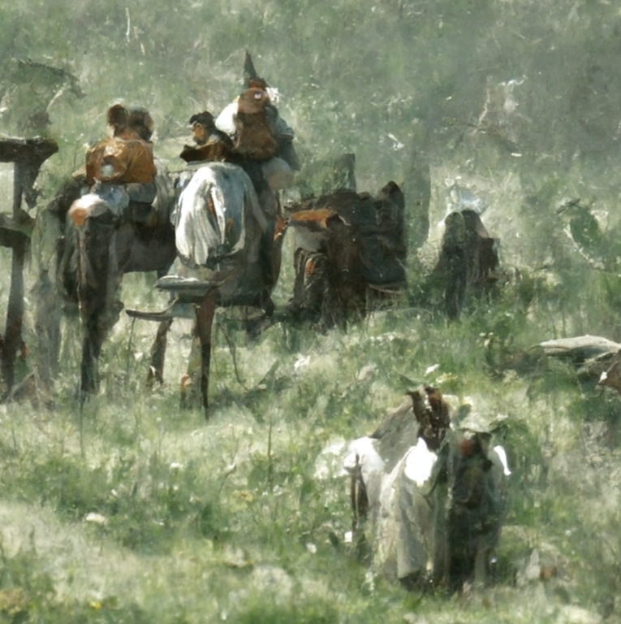
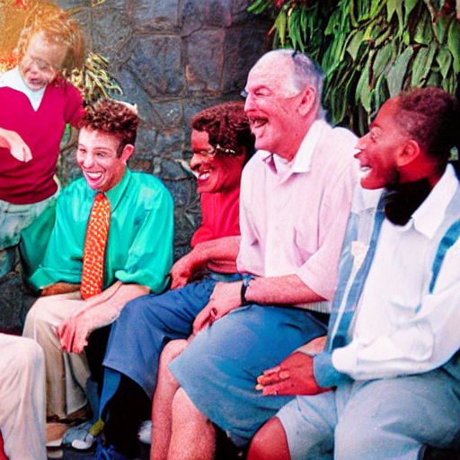
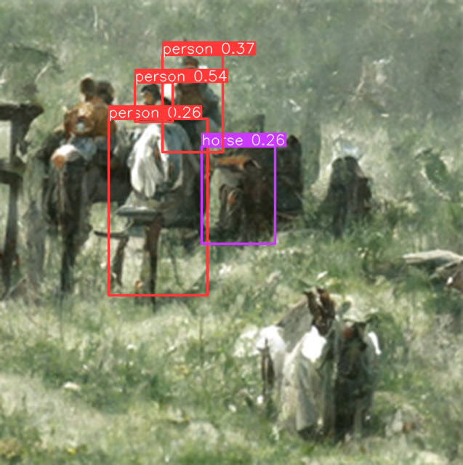
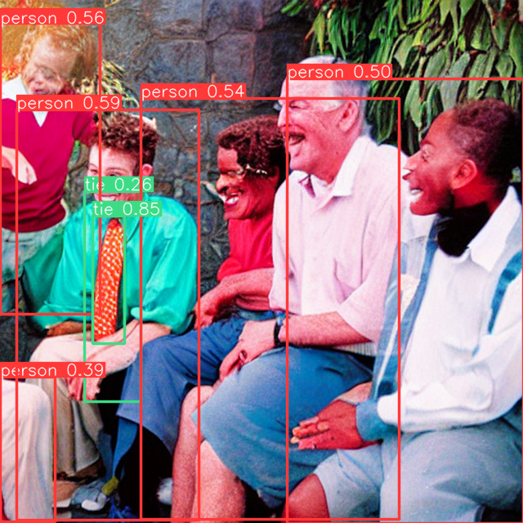
Advantages on Narrative Co-generation
Visual pipeline
Image generation from pure narratives
Enhance the flexibility in generation
Create immersion for design process
Provide potential creation suggestions based on image content
Potential challenges of sentence-based generation
→ No association information between images
Character and Environment Features
Image style
→ Inaccurate object recognition results
Variable quality of image generation
Bias in object recognition dataset
Weak zero-shot inference capability
“Ray gathered his friends to tell them a funny joke he heard.”

Slide 24
Advantages on Narrative Co-generation
Visual pipeline
Image generation from pure narratives
Prompt template
→ Disco Diffusion
Produce relevant figures with artistic quality
Carl Spitzweg splash-art style
→ Stable Diffusion
More robust drawing for character structure
Realistic photography style
Image feature extraction by target detection
→ Results combining from YOLOv5 & Faster R-CNN
→ Confidence level as a recommendation strength metric
“A colorful photo telling a story about [CONTEXT]”
“Ray gathered his friends to tell them a funny joke he heard.”
Notes:
Presenter: Brendan
I am now going to talk a little bit about the advantages of narrative co-generation. I won’t go too in-depth with this visual pipeline because it is not the focus of our project, but rather an application and extension that was developed in the prior research. This was not something we worked on or expanded in our project.
With the narrative generation, stories are often best depicted with images. In order to generate these images, two different types of diffusion were used. Disco diffusion, which is not pictured, stems from the Carl Spitzweg splash-art style. These images would be similar to those seen in tutorials or children’s picture books. The other type, stable diffusion, is pictured to the right, and this produces more realistic photos with clearly defined characters. You can notice that facial features and image details are pretty robust.
The other part of the visual pipeline is the image feature extraction by detecting targets in an image. This uses confidence level as an accuracy metric and combines several image detection methods, such as YOLO, which is “You Only Look Once”. This can be helpful when detecting the same person throughout a story of images.

Slide 25
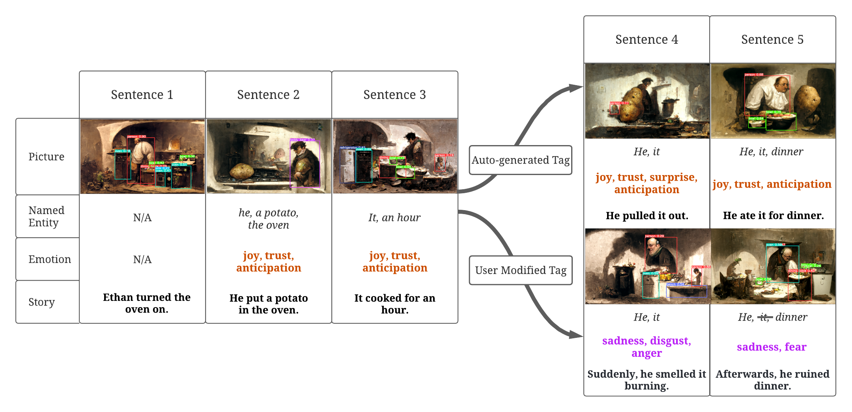
Advantages on Narrative Co-generation
Demo
Controlled interactive story generation
User can modify suggested keywords for real-time plot changes based on requirements

Slide 26
Demo
http://vsg-ek.herokuapp.com/
Notes:
And here is our demo time!
0
[Emotion]
[Keyword]
Oswald decided to write a novel.
[generate image using this]
1
joy, trust, anticipation
Plan A: He, book, month
Plan B: He, book
A: He worked on his book for several months.
B: he worked on the book all summer
2
joy, anticipation
Oswald, the book, publisher
Oswald took the book to a publisher.
3
Plan A:
fear, sadness, disgust
Plan B:
joy, trust, surprise
publisher, book
A: The publisher rejected his book almost immediately.
B: a publisher agreed publish the book.
4
[Follow B]
book, Oswald
the book was discovered and Oswald was happy.

Slide 27
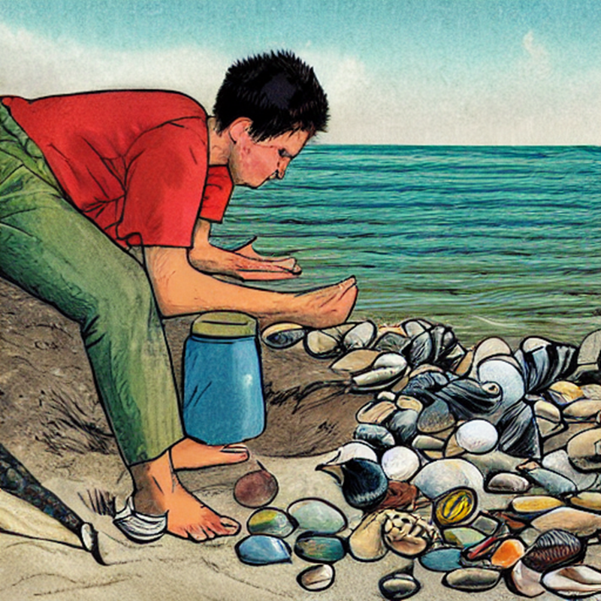
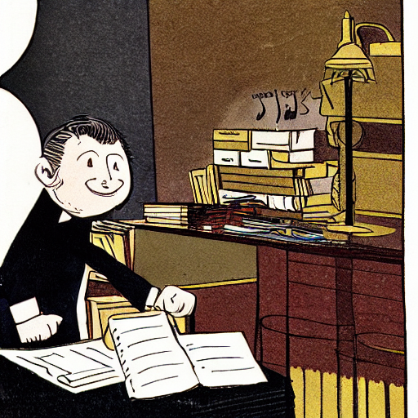
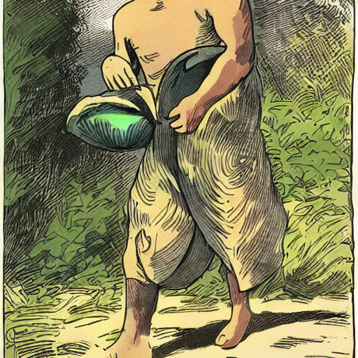
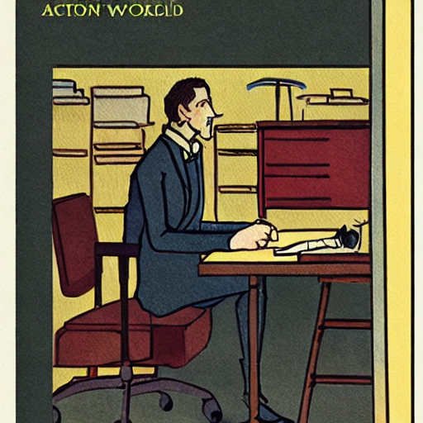

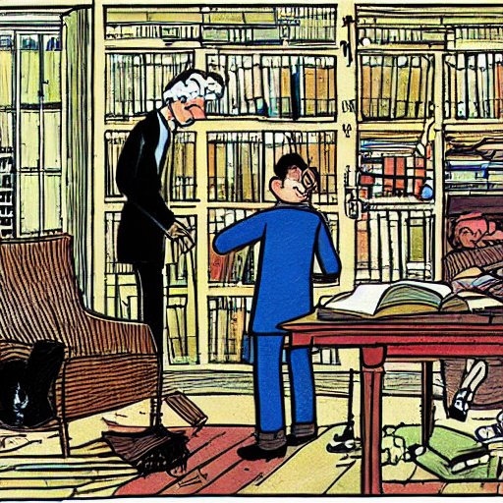
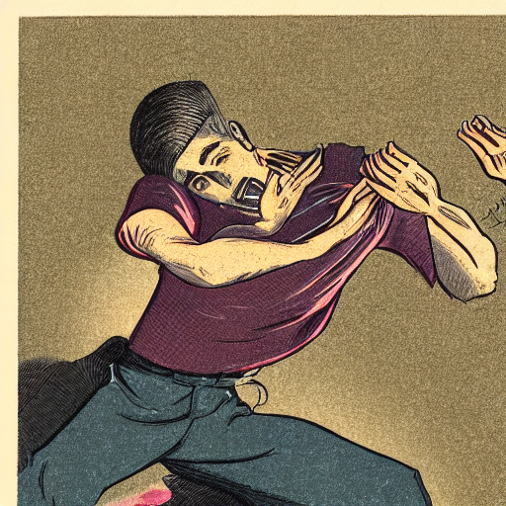
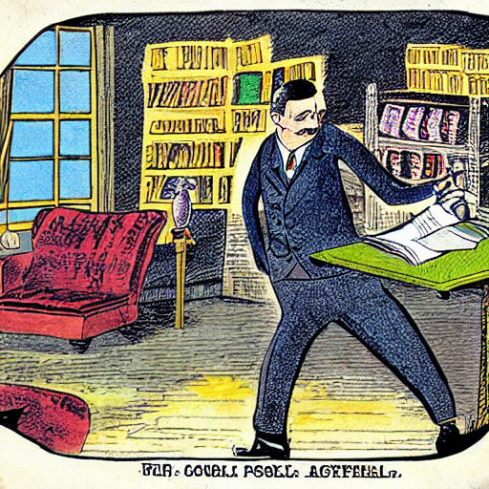
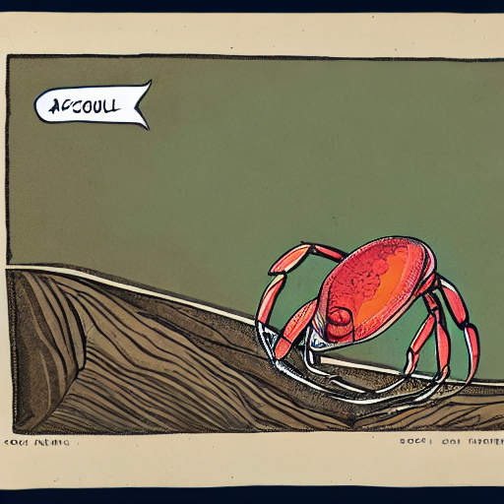
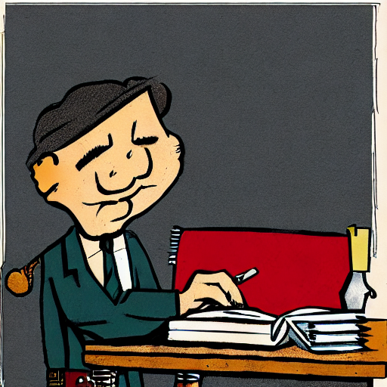
Advantages on Narrative Co-generation
Demo - sample generation results
# | Sentence
0 | Marcus was collecting shells on the beach.
1 | He picked up a large beautiful shell.
2 | He put it in his pocket to save for later.
3 | Suddenly he felt a sharp pinch.
4 | A crab was inside the shell pinching his leg.
# | Sentence
0 | Oswald decided to write a novel.
1 | He worked on his book for several months.
2 | Oswald took his book to a publisher.
3 | The publisher rejected his book almost immediately.
4 | Oswald decided to give up on writing.
# | Sentence
0 | Marcus was collecting shells on the beach.
1 | He picked up a large beautiful shell.
2 | He put it in his pocket to save for later.
3 | Suddenly he felt a sharp pinch.
4 | A crab was inside the shell pinching his leg.
# | Sentence
0 | Oswald decided to write a novel.
1 | He worked on his book for several months.
2 | Oswald took his book to a publisher.
3 | The publisher rejected his book almost immediately.
4 | Oswald decided to give up on writing.
...
Notes:
Presenter: Brendan
As you saw in the demo, this is a powerful model that can produce many results. Here are two such examples for a five-sentence story, similar to the structure of the ROCStories data (in the training set). (Read through the examples) Notice how the visual pipeline is to the right of the story. Although it is not the focus of our project, you can notice some of the diffusion methods in action as images are produced for each corresponding sentence. In these examples, the text generation understands the use of pronouns such as “it” and “shell” referring to the same thing. However, in the image pipeline, for the example on the right, the person Oswald is represented as a different character in each consecutive image even though he should look the same throughout an entire story.

Slide 28
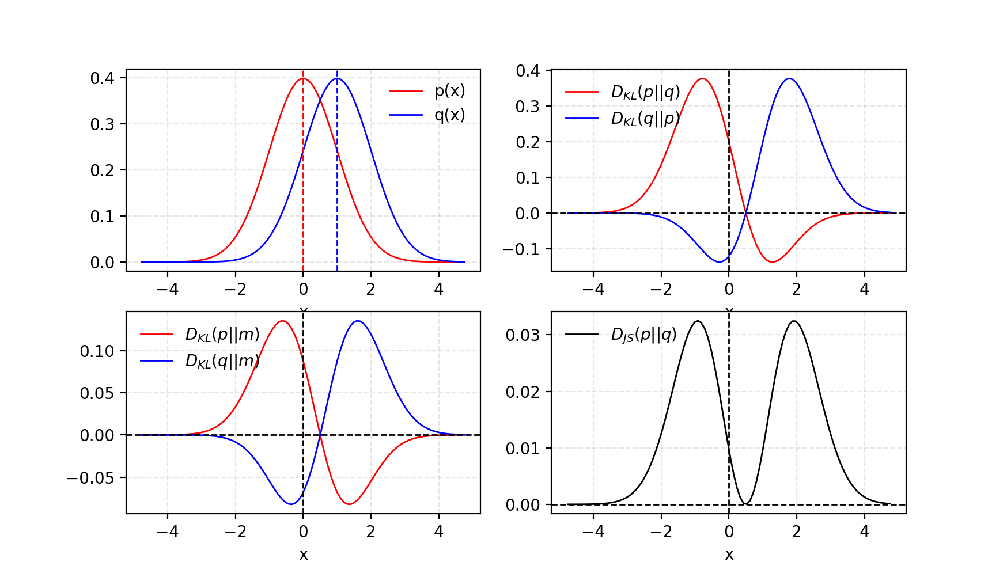
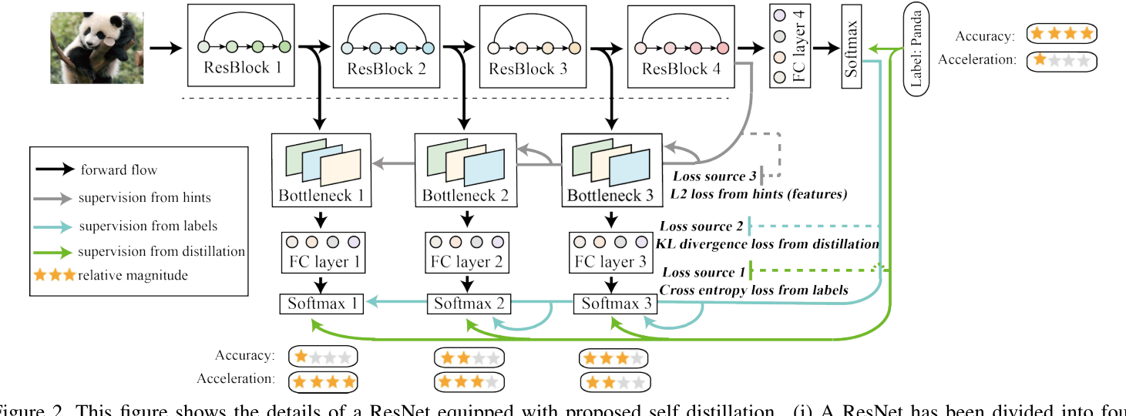
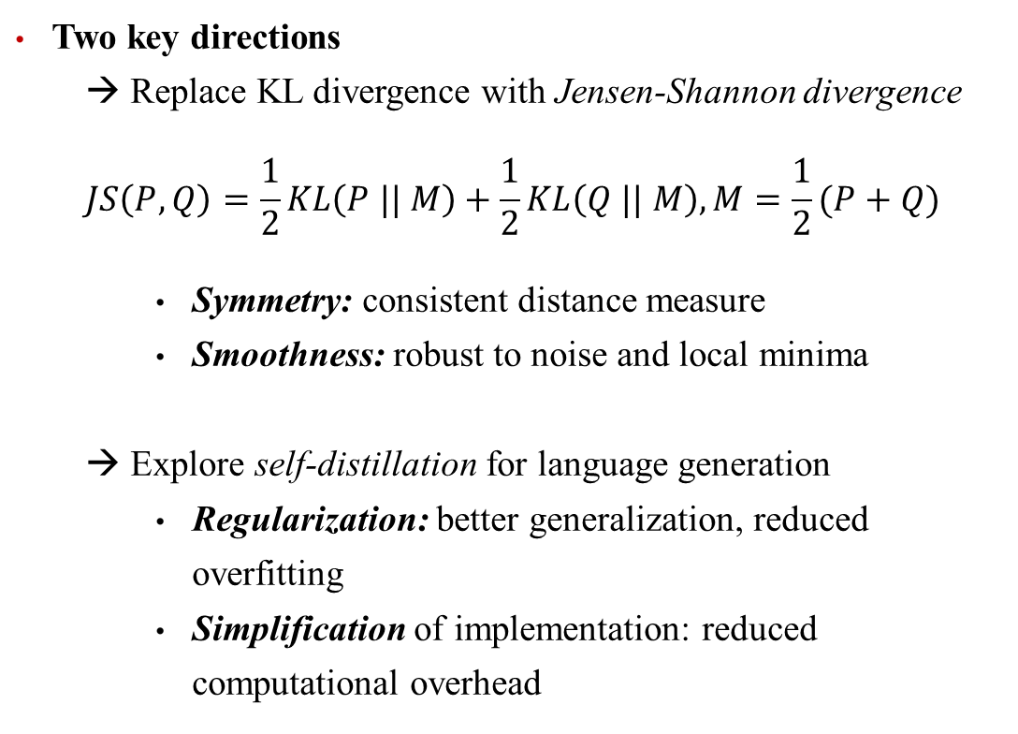
Future Works & Conclusion
Visual Story Generation Based on Emotional and Keyword Scheme
Two key directions
→ Replace KL divergence with Jensen-Shannon divergence
$$JS\left(P, Q\right)=\frac{1}{2}KL\left(P || M\right)+\frac{1}{2}KL\left(Q || M\right),M=\frac{1}{2}(P+Q)$$
Symmetry: consistent distance measure
Smoothness: robust to noise and local minima
→ Explore self-distillation for language generation
Regularization: better generalization, reduced overfitting
Simplification of implementation: reduced computational overhead
Notes:
Presenter: Brendan
In our discussion of future work, we will explore two primary avenues for improving the current implementation of knowledge distillation. First, we will consider replacing the Kullback-Leibler (KL) divergence with the Jensen-Shannon (JS) divergence. Second, we will explore the concept of self-distillation in the context of language generation.
Currently, KL divergence is used as a measure of difference between the teacher and student model's probability distributions. However, there are several reasons to consider using the Jensen-Shannon divergence as an alternative. Jensen-Shannon divergence is a symmetric measure derived from KL divergence, which offers some key advantages:
Symmetry: Jensen-Shannon divergence is symmetric, ensuring that the distance measure is consistent regardless of the order in which the probability distributions are considered. This property is valuable when comparing probability distributions, as it prevents potential discrepancies that could arise due to the non-symmetric nature of KL divergence. We can see this symmetry in the probability distributions to the right. The blue and red curves are equal and opposite distributions.
Smoothness: Jensen-Shannon divergence is smoother than KL divergence, making the optimization process more robust to noise and local minima in the loss landscape.
Another promising direction for future work is exploring self-distillation in the context of language generation. Self-distillation involves training a model on its own output, using the same model architecture for both the teacher and student models. This approach has shown promising results in various tasks, including image classification and natural language processing, and could be applied to language generation as well. You can see an example of this in the image on the bottom right where the model is teaching itself.
There are several potential benefits of using self-distillation for language generation:
Regularization: Self-distillation can act as a form of regularization, encouraging the model to learn a smoother probability distribution over the output tokens. This can lead to better generalization performance and reduced risk of overfitting.
Simplification of Implementation: In self-distillation, both the teacher and student models have the same architecture, which simplifies the implementation process. This also reduces the computational overhead associated with maintaining two separate models during training.
Therefore, by exploring the use of Jensen-Shannon divergence and self-distillation in the context of language generation offers promising avenues for future work. These approaches have the potential to improve the stability, performance, and simplicity of knowledge distillation methods in language generation tasks.

Slide 29
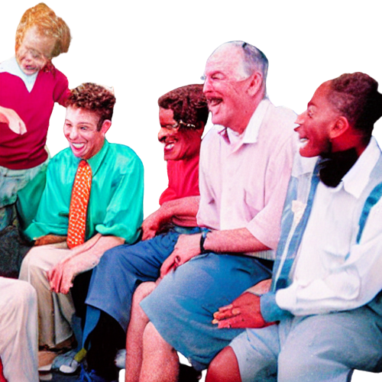
Future Improvement on Prompting and Model Selection
Performance-oriented optimization
Entities Extraction
Increase the scale of generated stories
Expand the number of sentences
Increase plot diversity
Prompting Optimization
→ Enable the model to further understand the task
Continuous prompting
Inductively valid template
→ Ensure the unity of the direct elements of the picture
Image prompting
…
Enhance the coupling between text and visual
→ Learning language generation from visual features supervision
Next Sentence from Text Pipe
Generated Image for Next Sentence

Slide 30
Reference
Banerjee, S., and Lavie, A. 2005. METEOR: An automatic metric for MT evaluation with improved correlation with human judgments. In Proceedings of the ACL Work- shop on Intrinsic and Extrinsic Evaluation Measures for Machine Translation and/or Summarization, 65–72. Ann Arbor, Michigan: Association for Computational Linguistics.
Fan, A.; Lewis, M.; and Dauphin, Y. 2018. Hierarchical neural story generation. In Proceedings of the 56th Annual Meeting of the Association for Computational Linguistics (Volume 1: Long Papers), 889–898. Melbourne, Australia: Association for Computational Linguistics.
Gerv ́as, P.; D ́ıaz-Agudo, B.; Peinado, F.; and Herv ́as, R. 2005. Story plot generation based on cbr. In Knowl. Based Syst.
Ibrahim, B. I. E.; Eyharabide, V.; Le Page, V.; and Billiet, F. 2022. Few-shot object detection: Application to medieval musicological studies. Journal of Imaging 8(2).
Kiros, R.; Zhu, Y.; Salakhutdinov, R. R.; Zemel, R.; Urta- sun, R.; Torralba, A.; and Fidler, S. 2015. Skip-thought vectors. In Cortes, C.; Lawrence, N.; Lee, D.; Sugiyama, M.; and Garnett, R., eds., Advances in Neural Information Processing Systems, volume 28. Curran Associates, Inc.
Li, B.; Lee-Urban, S.; Johnston, G.; and Riedl, M. 2013. Story generation with crowdsourced plot graphs. Proceed- ings of the 27th AAAI Conference on Artificial Intelligence, AAAI 2013 598–604.
Lin, C.-Y., and Och, F. J. 2004. ORANGE: a method for evaluating automatic evaluation metrics for machine trans- lation. In COLING 2004: Proceedings of the 20th Interna- tional Conference on Computational Linguistics, 501–507. Geneva, Switzerland: COLING.
Lin, T.-Y.; Maire, M.; Belongie, S.; Bourdev, L.; Girshick, R.; Hays, J.; Perona, P.; Ramanan, D.; Zitnick, C. L.; and Doll ́ar, P. 2014. Microsoft coco: Common objects in context.
Lin, T.-Y.; Doll ́ar, P.; Girshick, R.; He, K.; Hariharan, B.; and Belongie, S. 2016. Feature pyramid networks for object detection.
Lin, B. Y.; Zhou, W.; Shen, M.; Zhou, P.; Bhagavatula, C.; Choi, Y.; and Ren, X. 2019. Commongen: A constrained text generation challenge for generative commonsense rea- soning. arXiv preprint arXiv:1911.03705.
Liu, D.; Li, J.; Yu, M.-H.; Huang, Z.; Liu, G.; Zhao, D.; and Yan, R. 2020. A character-centric neural model for auto- mated story generation. Proceedings of the AAAI Confer- ence on Artificial Intelligence 34(02):1725–1732.
Meehan, J. R. 1977. Tale-spin, an interactive program that writes stories. In IJCAI.
Montfort, N. 2007. Generating narrative variation in inter- active fiction. Dissertations available from ProQuest.
Mostafazadeh, N.; Chambers, N.; He, X.; Parikh, D.; Batra, D.; Vanderwende, L.; Kohli, P.; and Allen, J. 2016a. A corpus and evaluation framework for deeper understanding of commonsense stories. arXiv preprint arXiv:1604.01696.
Mostafazadeh, N.; Grealish, A.; Chambers, N.; Allen, J.; and Vanderwende, L. 2016b. CaTeRS: Causal and temporal re- lation scheme for semantic annotation of event structures. In Proceedings of the Fourth Workshop on Events, 51–61. San Diego, California: Association for Computational Linguis- tics.
Onega, S., and Landa, J. A. G. 2014. Narratology: an intro- duction. Routledge.
Post, M. 2018. A call for clarity in reporting BLEU scores. In Proceedings of the Third Conference on Machine Trans- lation: Research Papers, 186–191. Belgium, Brussels: As- sociation for Computational Linguistics.
Radford, A.; Kim, J. W.; Hallacy, C.; Ramesh, A.; Goh, G.; Agarwal, S.; Sastry, G.; Askell, A.; Mishkin, P.; Clark, J.; Krueger, G.; and Sutskever, I. 2021. Learning transferable visual models from natural language supervision.

Slide 31
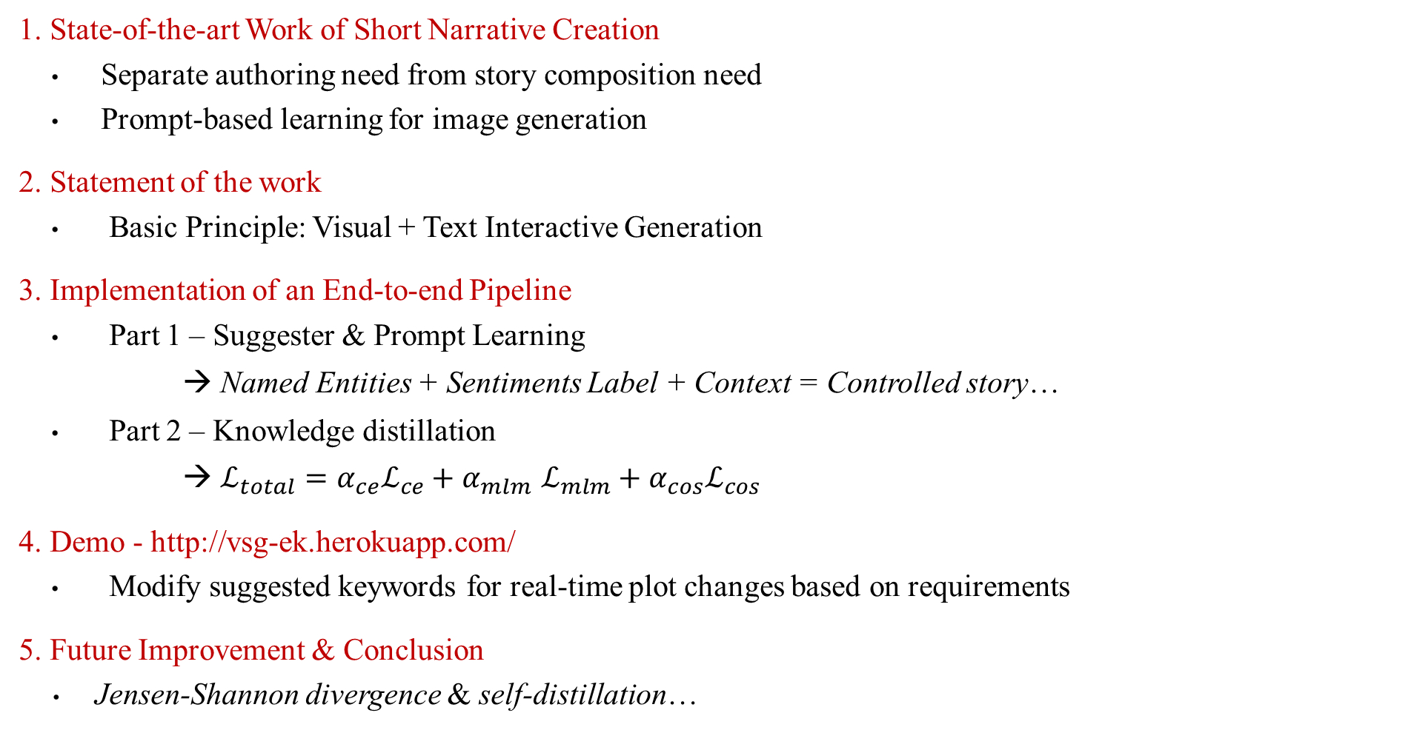
Q & A
1. State-of-the-art Work of Short Narrative Creation
Separate authoring need from story composition need
Prompt-based learning for image generation
2. Statement of the work
Basic Principle: Visual + Text Interactive Generation
3. Implementation of an End-to-end Pipeline
Part 1 – Suggester & Prompt Learning
→ Named Entities + Sentiments Label + Context = Controlled story…
Part 2 – Knowledge distillation
→ $ℒ_{total}=α_{ce}ℒ_{ce}+α_{mlm}$ $ℒ_{mlm}+α_{cos}ℒ_{cos}$
4. Demo - http://vsg-ek.herokuapp.com/
Modify suggested keywords for real-time plot changes based on requirements
5. Future Improvement & Conclusion
Jensen-Shannon divergence & self-distillation…

